Slide 1
Detecting drowsiness early with EEG
Philip Bjur, Noor Khan,
André Defte, Mona Jiwad
Notes:
The first slide should include the group name - You should state the problem, why this a problem, and how you went by to solve it preferably with a video.

Slide 2
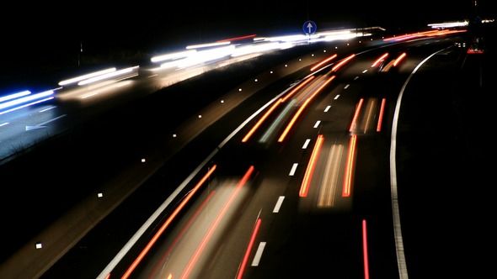
Problem and solutions
About 25- 30 % of car crashes are caused by fatigue
Previous systems focus on activating at late stage of fatigue
With EEG Cap one can detect and warn the driver in time
Video on EEG cap function: https://youtu.be/0UXVa451JV4
Video on EEG Cap function: https://drive.google.com/file/d/1xexuh-rztBokxKVNmebXFSgcg2saFgR7/view?usp=sharing
Notes:
The second slide should go deeper into why this is a problem and an alternative solution used so far
introduktion
produkter på marknaden idag
vad vi gjort

Slide 3
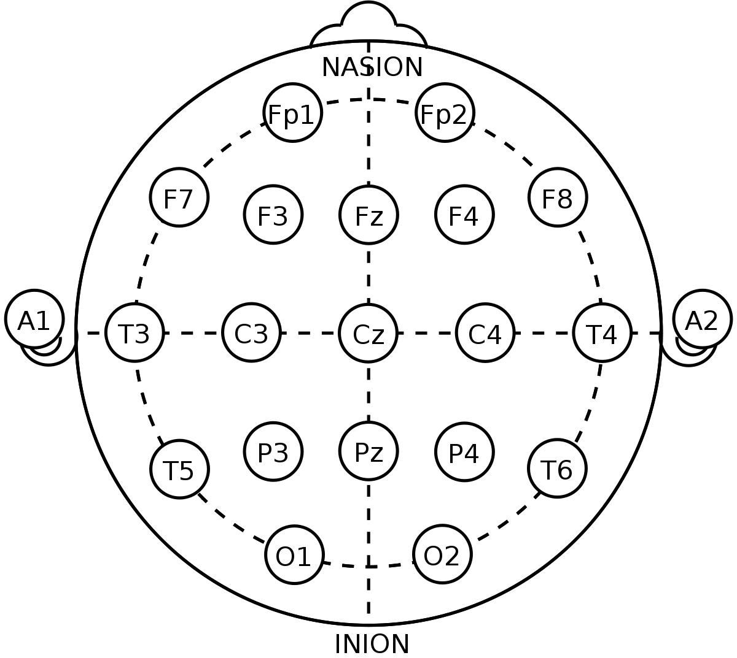

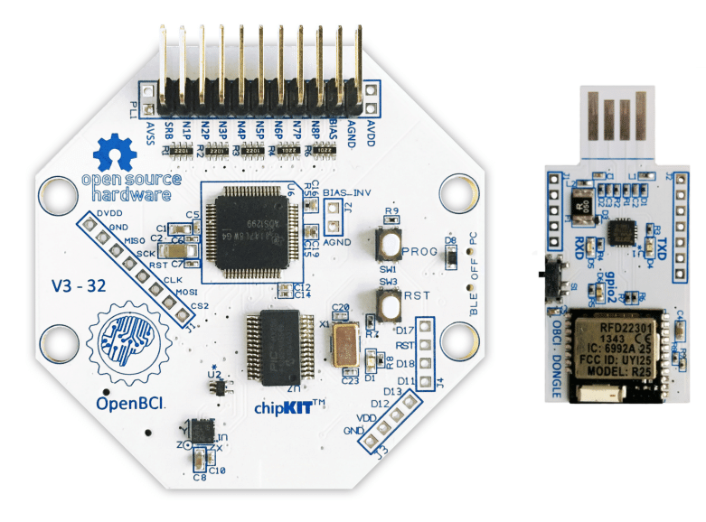
EEG Cap
Open BCI Cyton
Matlab used for programming filters and analyzing raw data
10 - 20 system for placement of EEG electrodes
Bluetooth connection to computer
Notes:
The third slide should include a general description of the solution that you have created.
varför
artiklar, rapporter
bra för
behov

Slide 4
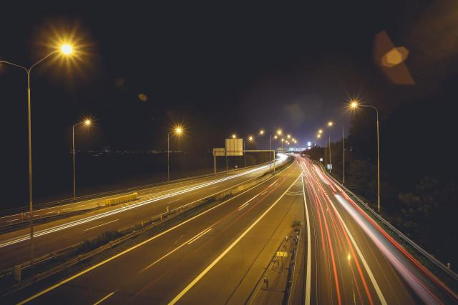
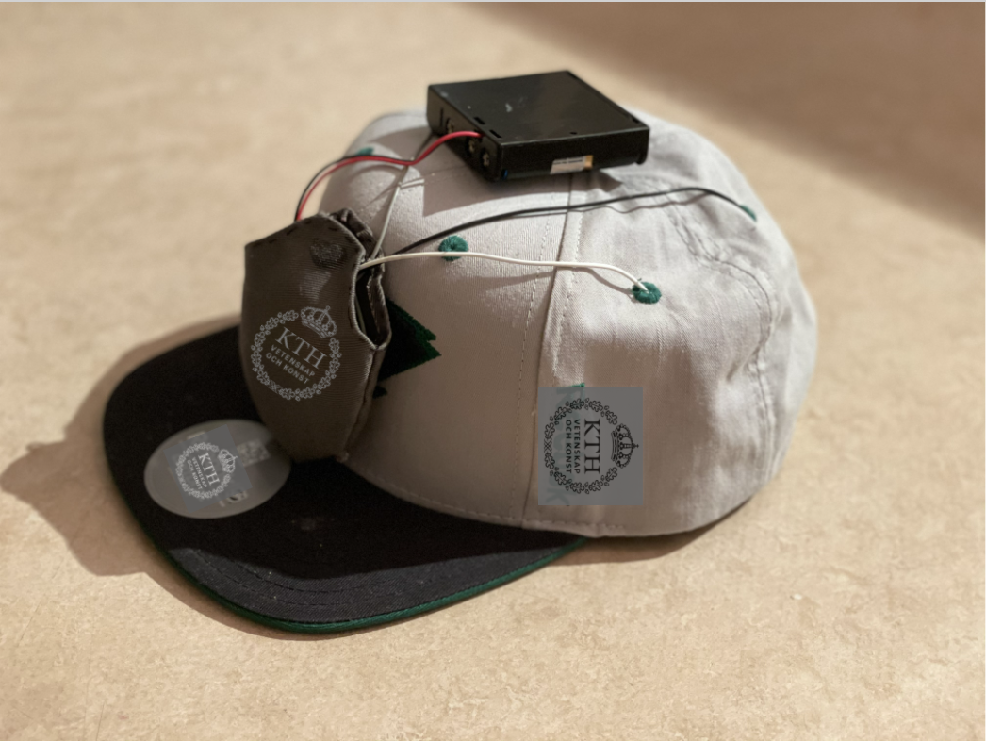
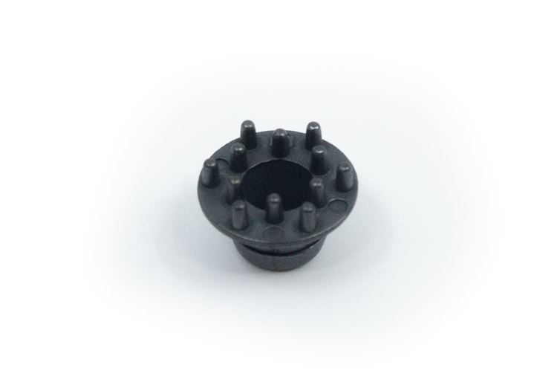
Achievements
Does not interfere when driving
Comfortable and easy to use!
With our programming we are able to easily determine different values of the frequencies
Easy to take off/on the cap
Dry electrodes
Video on our future vision with EEG cap: https://youtu.be/WODnPWR7ag0
Notes:
The fourth slide should cover a technical part that the group are particularly happy with

Slide 5
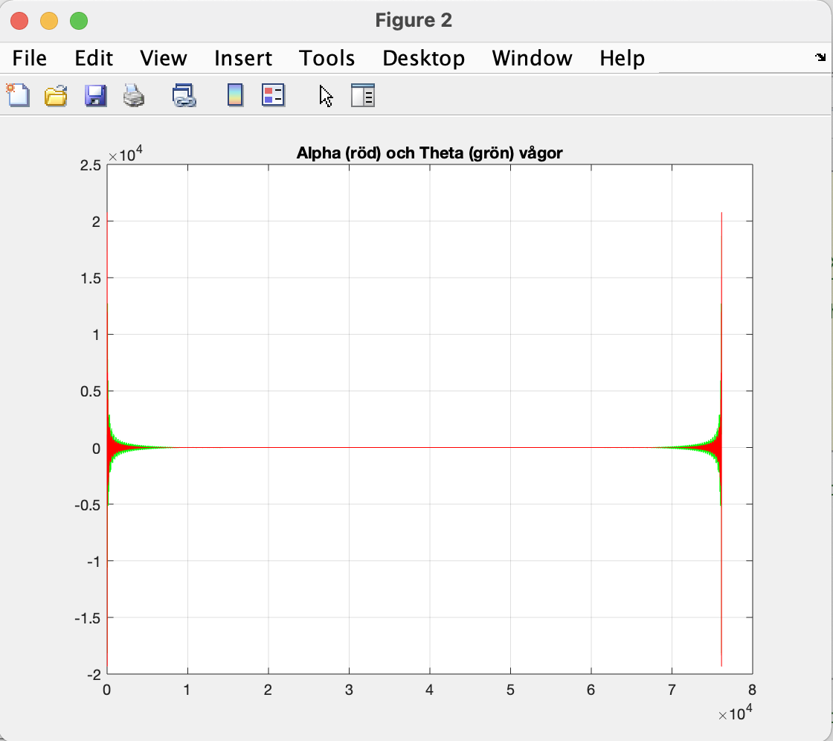
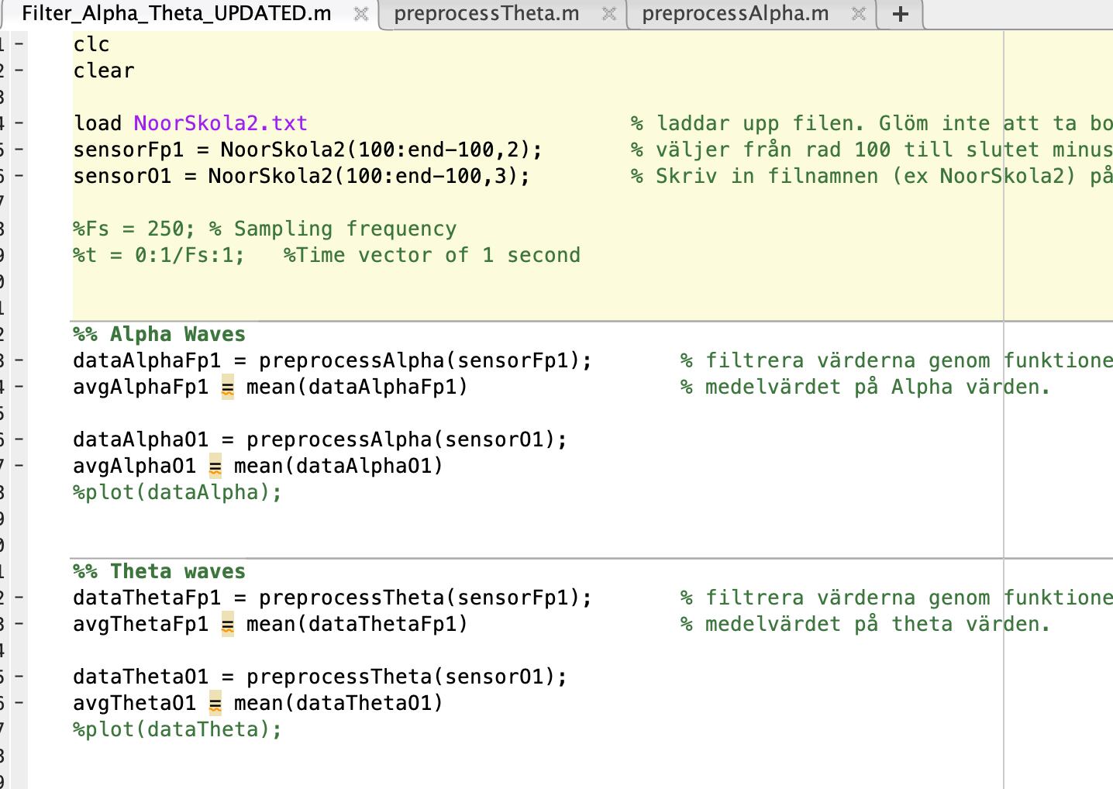
Result
Artifacts in the data by external forces
Our results showed a decrease in amplitude both in alpha and theta waves. Which does not agree with previous studies.
Notes:
Slide 5
The results we got from our experiments did however not agree with what we anticipated. Our experiments and measurements showed an decrease in the amplitude of alpha and theta waves in case of fatigue. These results didn’t agree with other studies that are mentioned in the report, which instead showed an increase in the amplitude. We believe that the difference in the results are related to external mechanical influences.
Furthermore the measured results turned out to be difficult to interpret as external forces on wires and electrodes gave disturbances and strong artifacts in the results. As we can see in the second figure where the amplitudes are quite high at the beginning and at the end.
These artifacts were unrealistically high (and low, negative) which have made it difficult to present valid values and calculate averages.
As the end product is intended to be worn on the head when driving vehicles, these mechanical disturbances become an imminent problem that our work (and thus the report) have not explored.

Slide 6

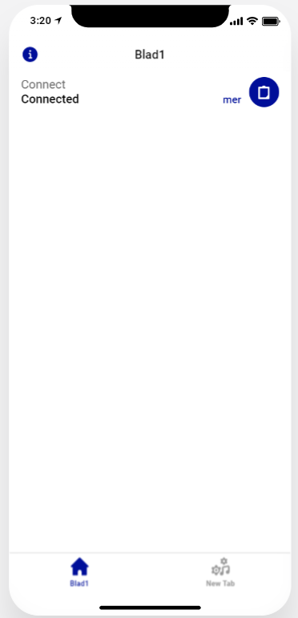

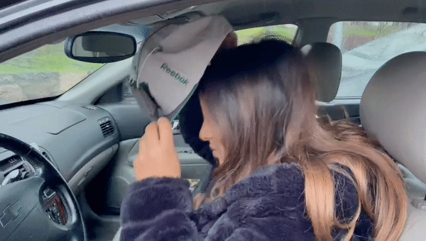
Our future vision
Dynamic suspension device in the cap to maintain a perfect friction against the skin
EEG Cap
Well-insulated cables, soldered directly to the circuit board.
Develop an app to alarm the driver
Connect
Notes:
We believe that with further research on a stabilizing function, we can achieve the vision of a fully functional end product. This could be accomplished with well-insulated cables, soldered directly to the circuit board.
We also want to make sure that the electrode has a dynamic suspension device in the cap's contact with the frontal lobe. Where the purpose is to maintain a perfect friction against the skin for good contact. This at the same time as the cap is allowed to shake and move freely, with a stepless movement in all directions.
As you also saw in our vision video we also want to develop an app that can easily connect to the EEG cap making it more portable. There will also be an alarm system which will warn the driver when he gets tired. By using the obtained values thru the cap, we want to make a program that would analyze the amplitudes of the signals in the low frequency ranges of the brain and then compare it with the set threshold values which will be obtained by using data averages. When the measured value exceeds the threshold value, the application would then be activated and the user alerted, as shown in the video.
We hope that with these future visions we will be able to develop a product that can be used to save and make the roads a safer place.
This was everything from us and our project.

